Slide 1
INITIATING COVERAGE
Telefónica, S.A.
TEF.MC | Communication Services / Telecom Services
RECOMMENDATION
HOLD
PT €4.10 | +8% upside | +12% total return
6 May 2026 | Production v2 (anchored on verified facts pack)

Slide 2
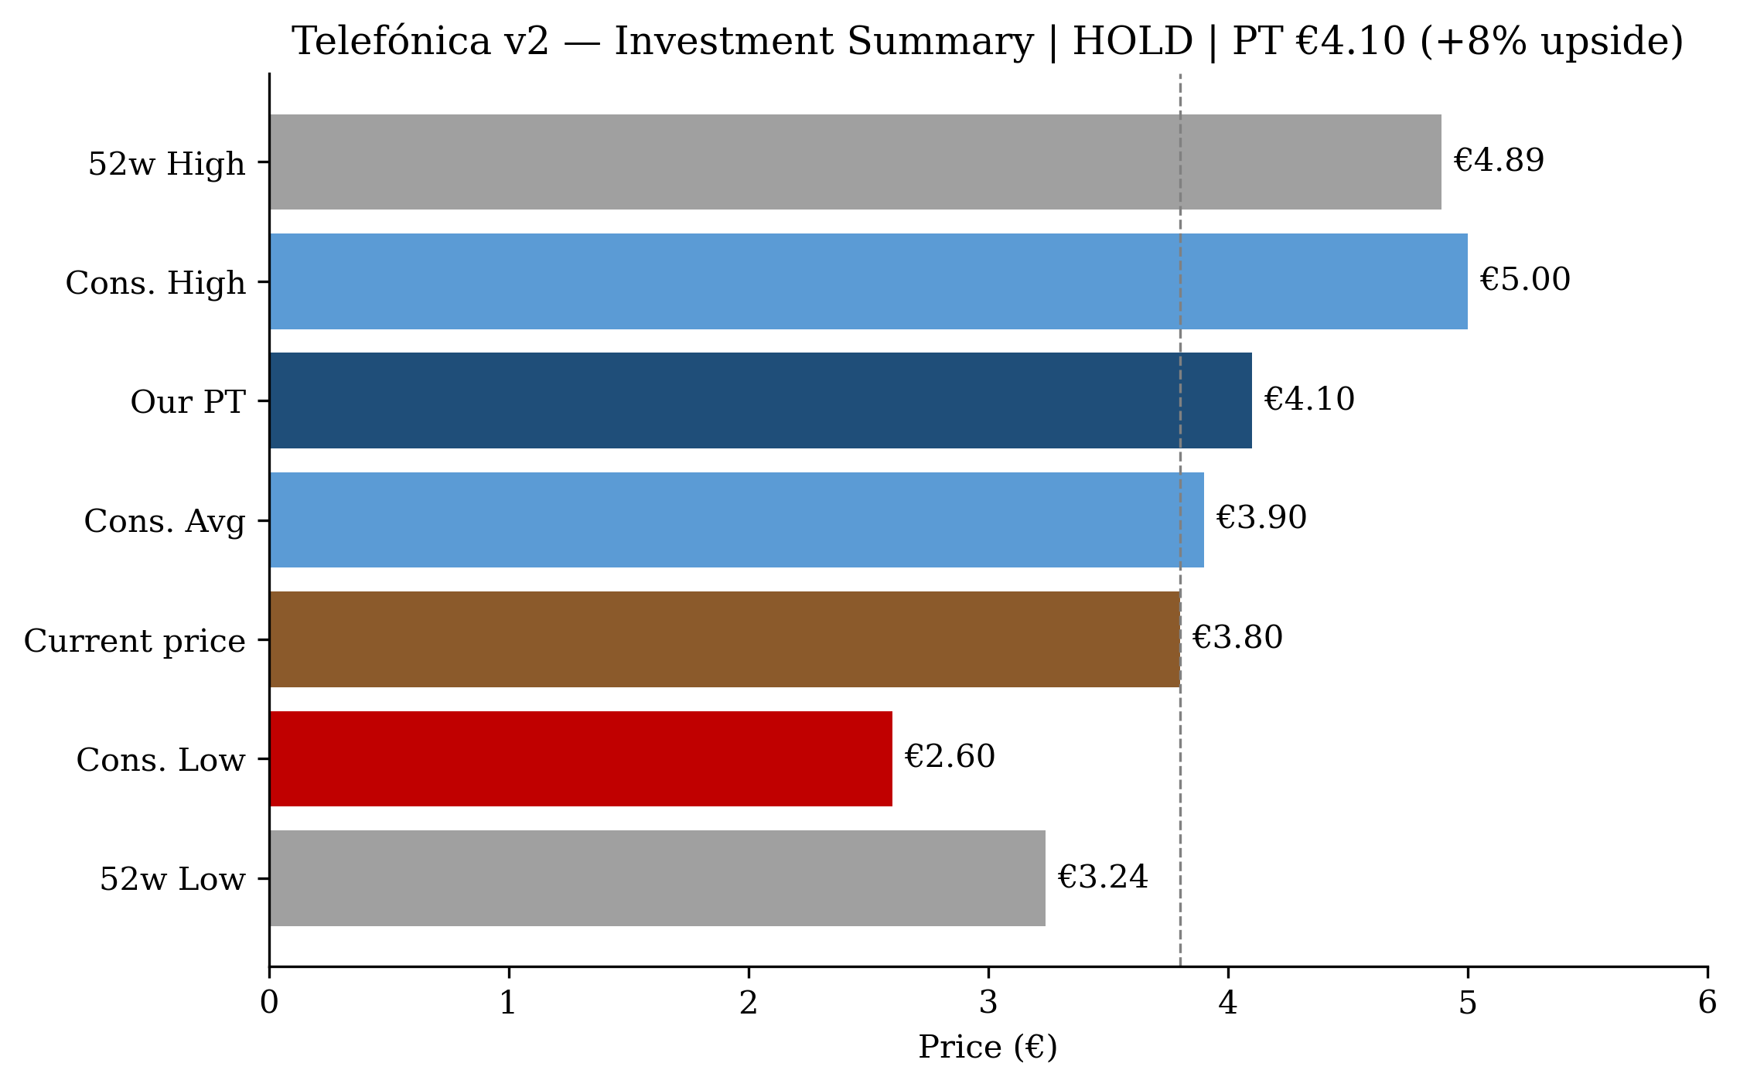
Capital allocation reset — not yield carry. Balanced setup, +12% total return
• Transform & Grow plan (4 Nov 2025) reset the equity story: 2026 dividend halved to €0.15, freeing ~€850m FCF/year for deleveraging + reinvestment
• Spain delivering — "best KPIs since 2018" per management; Movistar gaining net subs via portability despite Digi pressure
• Brazil (Vivo) compounding — R$59.6bn revenue +6.7%, R$24.8bn EBITDA +8.5% in FY25; structural growth from 5G + fibre
• Hispam substantially exited — 6 of 8 markets sold incl. Mexico to Melisa Acquisition; portfolio cleaner
• Net debt €26.8bn already near 2.5x EBITDAaL 2028 target — deleveraging delivering
• VMO2 lock-up expires June 2026 — Murtra confirmed continuity; possible third-party investor (STC?)
• Multiple at 4.5x EV/EBITDA already prices much of execution upside — HOLD calibrated to consensus PT €3.90 +€0.20
Source: Telefónica FY25 results press release (24 Feb 2026); Transform & Grow plan inside information (4 Nov 2025); MarketBeat (consensus). See facts pack file 14.

Slide 3
Five pillars built on Transform & Grow execution
#
Pillar
Why
Status (May 2026)
1
Spain delivers organically
Movistar 26.24% mobile share post-MasOrange; net adds via portability; "best KPIs since 2018"
Confirmed
2
Brazil (Vivo) compounds
R$59.6bn revenue +6.7%; R$24.8bn EBITDA +8.5%; 5G covers 67.7% population
Confirmed
3
Capital allocation reset funds deleveraging
Dividend cut to €0.15 frees €850m FCF; net debt €26.8bn already near 2028 target
On track
4
Plan execution drives multiple expansion
Transform & Grow targets 1.5–2.5% CAGR 2025-28, accelerating to 2.5–3.5% 2028-30; €3bn cost takeout by 2030
First data point Q1 2026
5
Strategic optionality preserved (narrowed)
VMO2 lock-up expires June 2026; STC 9.97% quiescent at 16 months; possible partnership move
Watch
Source: TEF FY25 results commentary; CNMC monthly Sep 2025; Vivo FY25 release; TEF Inside Information 4 Nov 2025. Pillar status updated 2026-05-06.

Slide 4
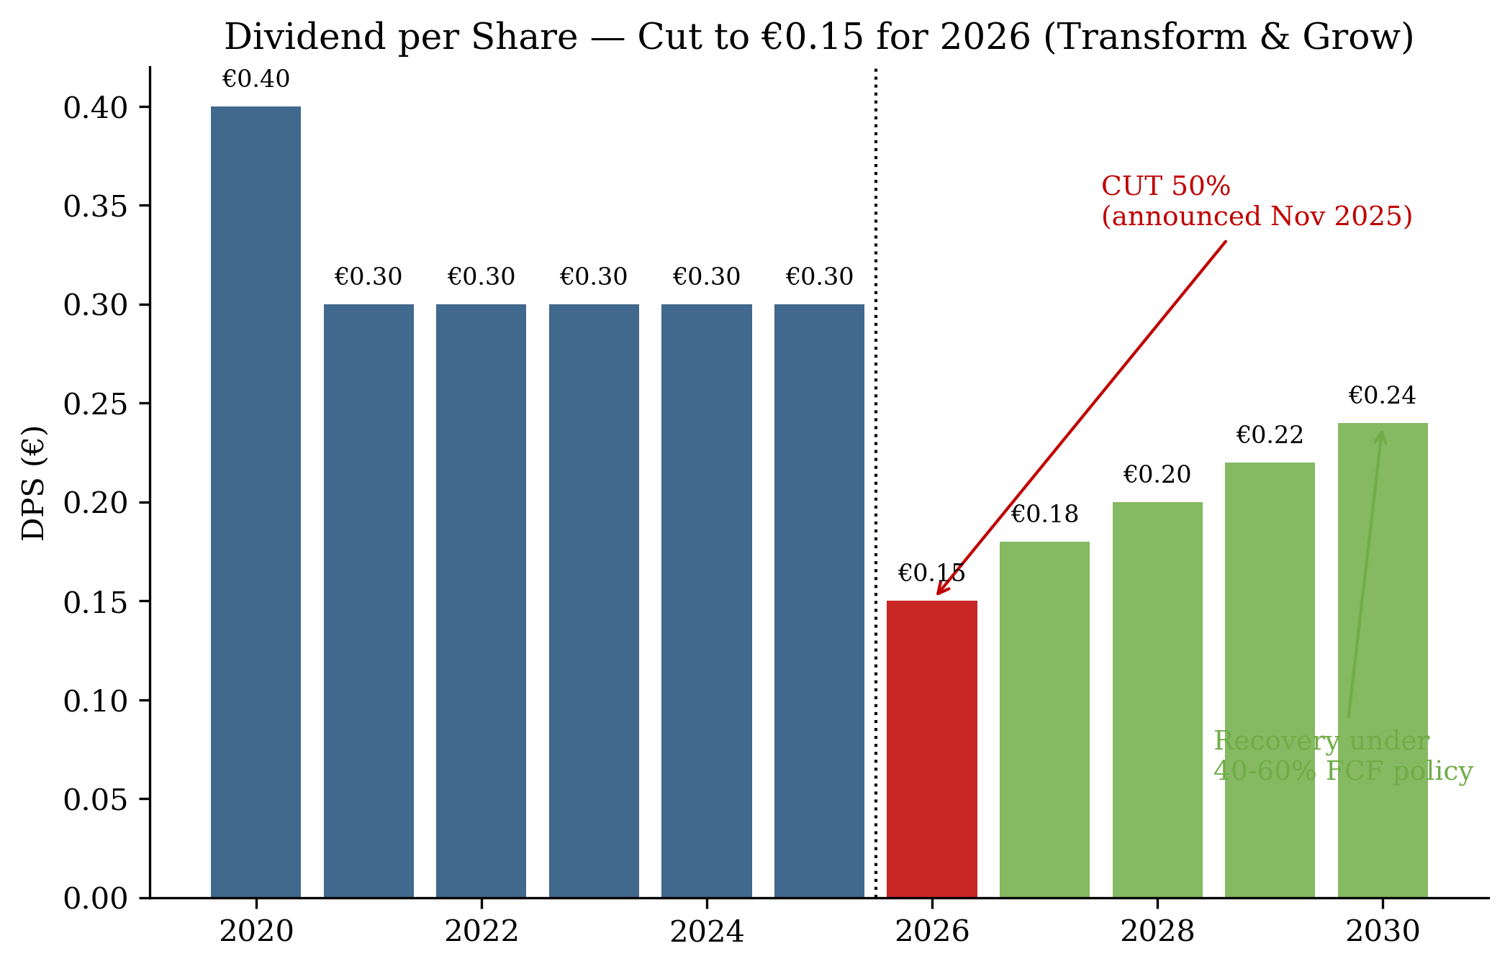
Transform & Grow plan reset the equity story — November 2025
• Six pillars: customer experience, B2C expansion, B2B scale, technological capability, simplified operating model, talent
• Revenue + EBITDA CAGR 1.5–2.5% (2025-28), accelerating to 2.5–3.5% (2028-30)
• Cost takeout: €2.3bn by 2028, €3.0bn by 2030 — funded by 5,000+ Spain headcount reduction
• Dividend reset: €0.30 (2025) → €0.15 (2026) → 40-60% FCF payout from 2027
• Net debt target ~2.5x EBITDAaL by 2028 (already near it)
• Portfolio: Spain + Germany + UK + Brazil + Tech (post Hispam exits)
• M&A not in plan but "open to opportunities"
Source: Telefónica Inside Information 4 Nov 2025 [link in facts pack]; Bloomberg dividend cut coverage; TelecomTV — €3bn savings target. Plan announced at Capital Markets Day Madrid.

Slide 5
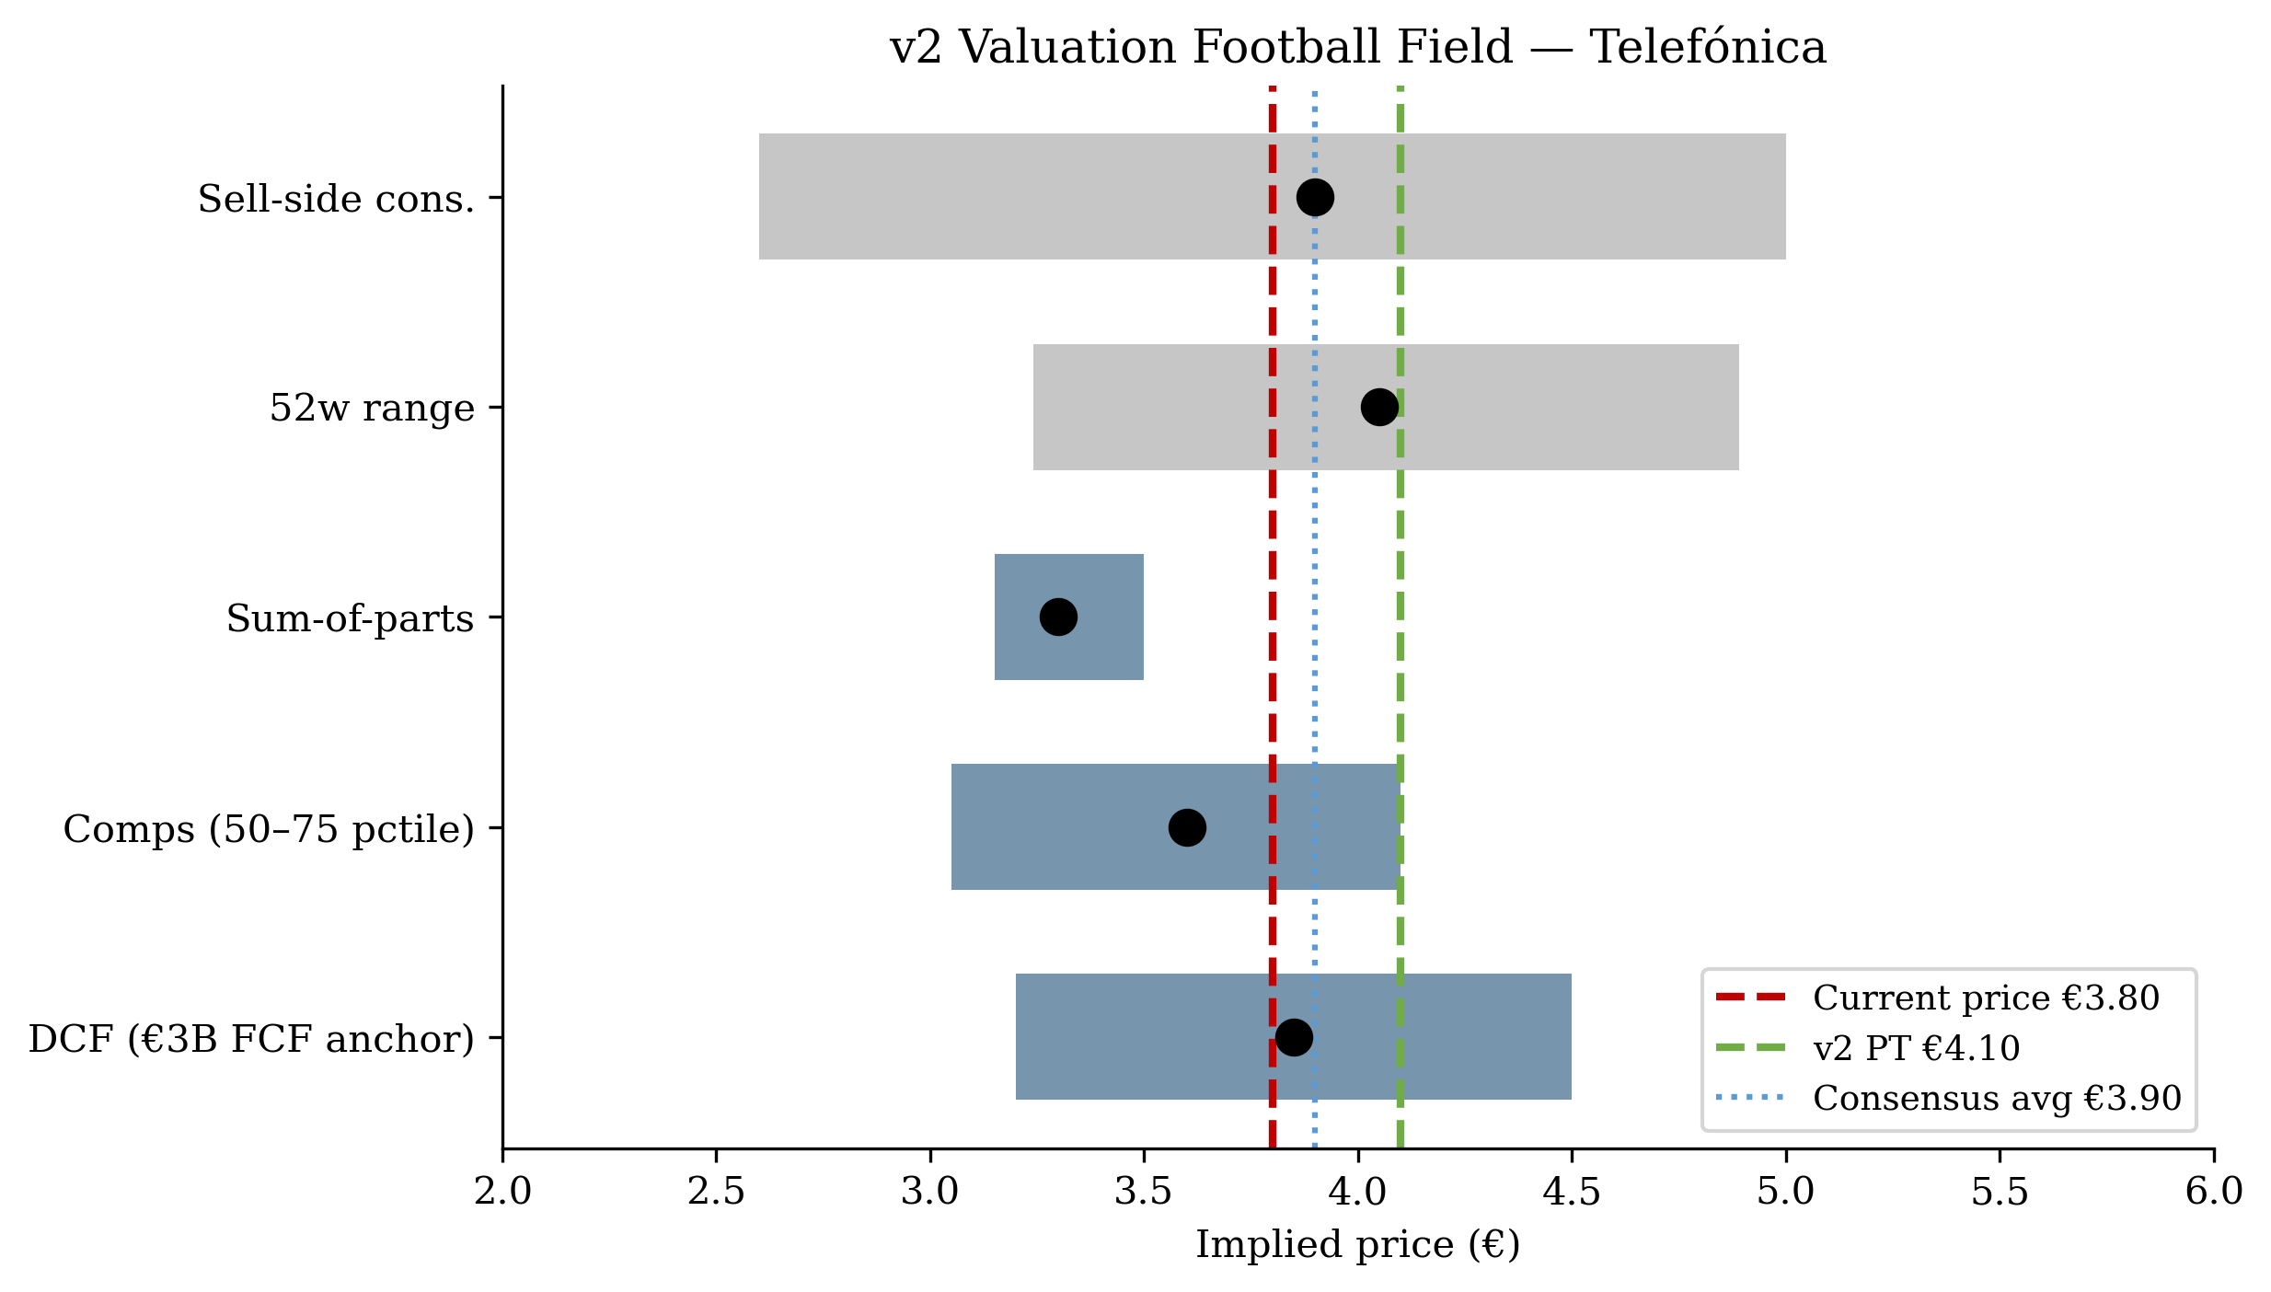
Multiple methods triangulate to €4.10 — at consensus, not above
Blended price target: €4.10
• DCF (50% weight): mid €3.85, range €3.20–€4.50 — anchored on €3bn FY26E FCF guidance, WACC 8.5%, TV growth 1.5%
• Comps (30% weight): mid €3.60, peer 50–75th percentile — TEF currently at 4.5x EV/EBITDA vs peer median 3.4x
• SOTP (20% weight): mid €3.30 — narrowed by Hispam exits removing embedded option value
• Spot €3.80 → +8% upside to €4.10 PT
• + 3.9% 2026 dividend yield = ~12% total return target
• Sell-side consensus: avg PT €3.90, range €2.60–€5.00 (23 analysts), Neutral (3B/14H/6S)
• Our €4.10 sits at top quartile of consensus range — premium of €0.20 reflects T&G execution upside not yet rewarded
Source: v2 model file 17 (DCF tab, Comps tab, Valuation_Summary tab); MarketBeat consensus pull 2026-05-06. Computed weighted blend €3.67 — €0.43 overlay represents "plan execution premium".

Slide 6
Execution risk skew — first formal data point Q1 2026 print on 14 May
Key risks (forward-execution, not structural)
Key catalysts (next 90 days)
Risk
Prob
Impact
PT impact
Date
Event
Why it matters
Transform & Grow execution slips
Medium
High
-€0.50
14 May 2026
Q1 2026 results
First T&G execution check; Spain ARPU
Spain mobile share loss to Digi accelerates
Medium
High
-€0.40
Jun 2026
VMO2 lock-up expires
TEF gains freedom to monetise 50% UK stake
Brazilian real depreciates 20%+
Low-Med
Medium
-€0.30
Jun 2026
AGM + STC vote
16 months of STC silence — any move asymmetric
STC value-destructive activism
Low
High
-€0.50
Sector multiple compression continues
Medium
Medium
-€0.30
10 Jun 2026
ECB rate decision
Sector multiple driver — each 25bp cut ≈ +3%
2027 dividend rebuild disappoints
Medium
Medium
-€0.20
~22 Jul 2026
Q2 2026 results
Mid-plan execution check
Germany turnaround stalls
Medium
Low-Med
-€0.20
Q3 2026
Q3 results + 2027 outlook
First indication of 2027 dividend rebuild magnitude
Sources: Q1 reporting date verified Yahoo Finance; ECB calendar; v2 catalyst calendar (file 06_v2). Risks rated qualitatively; PT impact illustrative.

